Slide 1
shopBLT Discussion Presentation
Phillip Nguyen
Matthew Morales
Jason Tam
Juwan Michael De Jesus
Alonso De La Torre Vega

Slide 2

About shopBLT
Founded 1991
Evolved from systems design and consulting firm (now e-commerce)
Providing over 300,00 items relating to:
Software, licensing, and electronics
Niche marketplace (high domain knowledge)

Slide 3

Usability Testing
Participants: - Sample Size: 5 - Recruited via: Social media, direct outreach, online connections Tasks: 1) Load the product page for any “monitor”, without using the search bar. 2) Reach the user information page with all fields completed and a monitor in the shopping cart. 3) Get customer service help for information on exchanging a product. 4) Find the dimensions of a (specific graphics card), using any method to navigate to the product page. 5) Find a “black mouse pad with a gel wrist rest” of any size, priced between $25-$35.

Slide 4
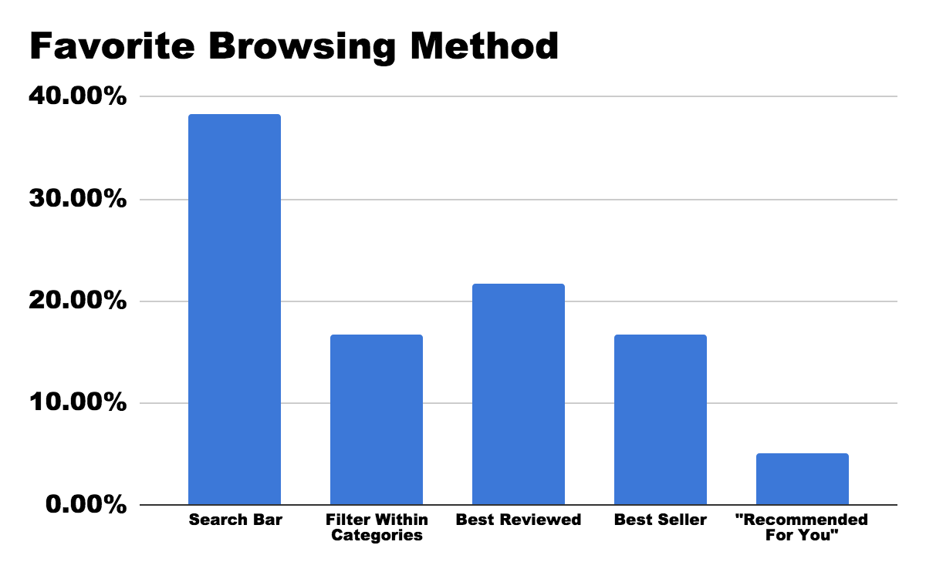
Findings
The Data Suggests:
Product Discovery:
Poor usability with Search Bar
Product Visibility:
No product image
Confusing and misleading product listing info
Feature Optimization:
Advanced Search Functions
Category Navigation
Misc.
Bad checkout process (i.e. outdated information)
No “logical” order in product search results
Notes:
The data we collected from the usability test falls in line with the data we received from out user interviews and surveys. After conducting the usability tests we used an affinity diagram to map out and categorize areas in which users experienced pain points. We then used a prioritization matrix with custom dimensions (user value gained, and feature complexity) and agreed on the areas in which the most feasible and worthwhile changes could be made. User data showed that a lot of people use the search bar, and one of the biggest issues is the lack of feature optimization for this tool. It uses a boolean retrieval algorithm that can produce false negatives when searching for a product and the wrong keyword is used.

Slide 5
Team Processes
We use SMS to communicate
Plan things out for assignments and distribute work
Get started on it early on to make sure we finish on time
We meet up in the ICS 2 - Kay lab for group work
We stay in constant communication to make sure everything is in order
Make a checklist of missing sections to complete
We are effective as a team and have completed all of our assignments with plenty of breathing room

Slide 6


Strengths and Improvements
Overall, we all work well with each other as a group
Meetups and deadlines are well established between one another
We all still feel the same way about the grade we are all trying to achieve
We could improve in our timing (ability to meet up, planning)
This could be improved by using scheduling tools or comparing our schedules thoroughly

Slide 7
Thank you!
Any Questions?

